Slide 1
WELCOME TO YEAR 3
Agenda
Introduction​
Meet our team
English Writing
and Reading
Handwriting
Mathematics
Times Tables
Science
Humanities- Geography and History
RE
PSHE
Art
Specialist Teaching
Celebrations
Homework
Reminders
Pupil Premium
Useful links
Questions and Answers

Slide 2
Introduction
4 classes per year group
Expectations for Key Stage 2 Year 3

Slide 3
MEET OUR team
Mrs. lachani
Miss Crick
Mrs. aii​
Miss Aloul
Assistant Headteacher for Year 3 and 4
Class teacher 3L
Class teacher of 3Y
Class teacher 3O
Mr. Mokadem
Mrs. Jackson
Mrs. Siva
Mrs. Goes
Class teacher 3N
Teaching Assistant
Teaching Assistant
Teaching Assistant

Slide 4
English
Autumn Term
Spring Term
Reading Comprehension
Summer Term

Slide 5
Reading
Children should be reading daily at home. Please listen to them read as often as possible.
Home Reading logs need to be signed by a parent/carer once a week.
It is important to question children whilst reading:
What is happening?
Why has this happened?
What were the key events? etc.

Slide 6
Reading
Children should bring their books to school every day.
Books will be given to children based on their ZPD level.
Children will take an online quiz about their book each week and are expected to get at least 60%.

Slide 7
Reading
Please ensure books are looked after.
Lost or damaged reading books will result in at least a £5.00 fine (dependent on the cost of the book).
Lost or damaged Logs will result in a £1.50 fine.
50p to replace the plastic wallet

Slide 8
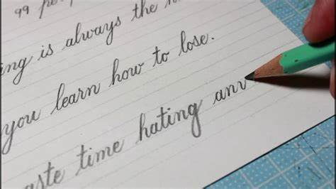
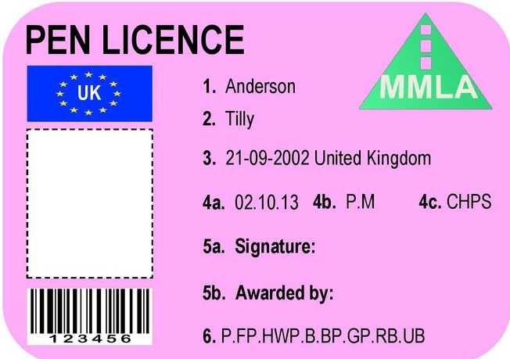
Handwriting
We are now teaching the children to write in cursive handwriting. Please encourage them to practise this at home. They will need to demonstrate amazing presentation in the books in order to get a pen licence!

Slide 9
mathematics

Slide 11
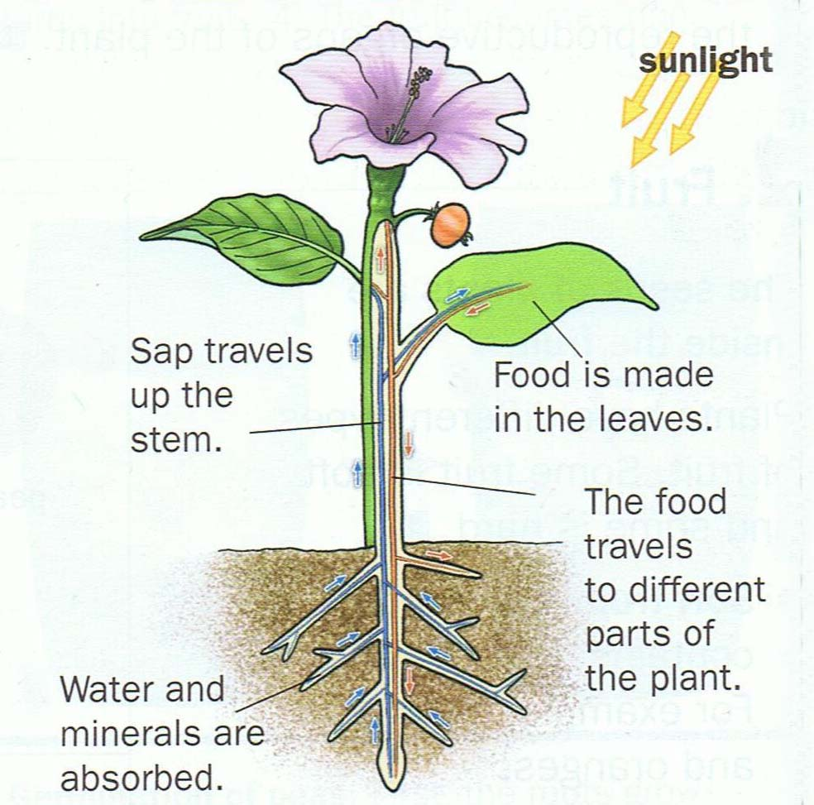
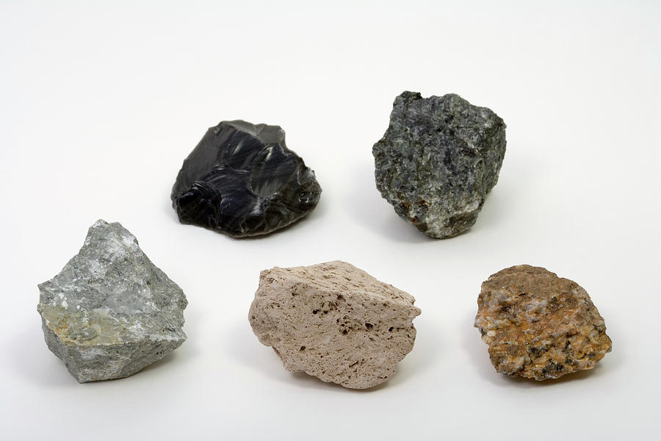
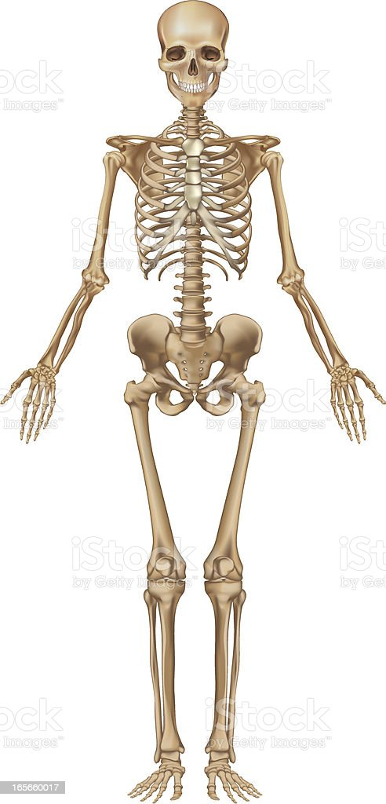
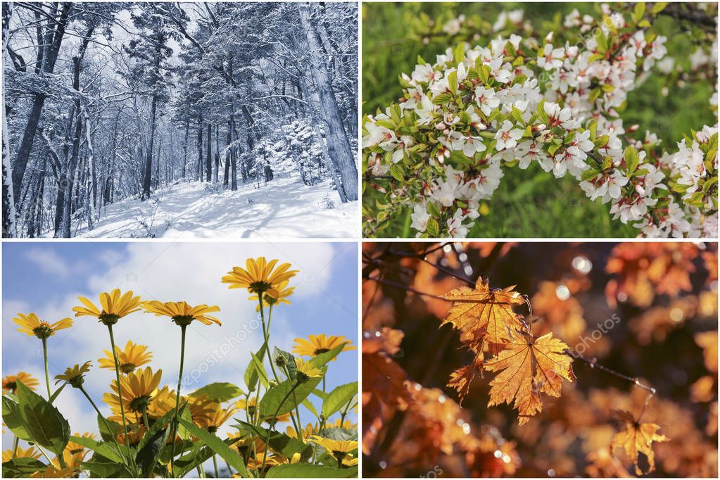
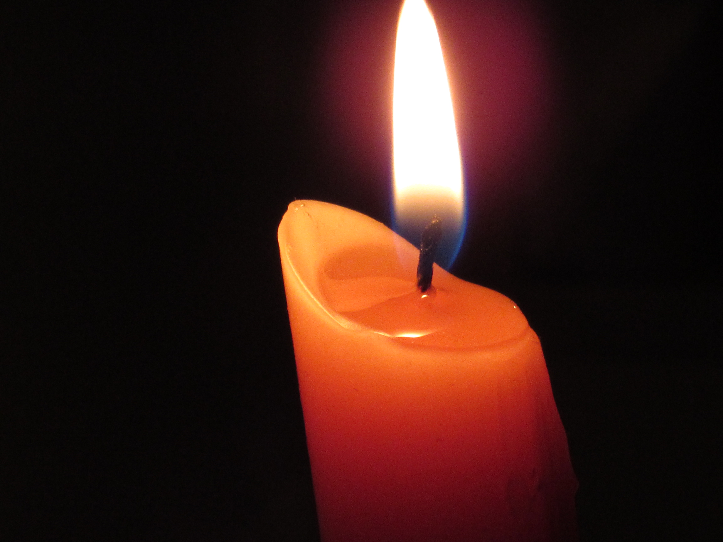
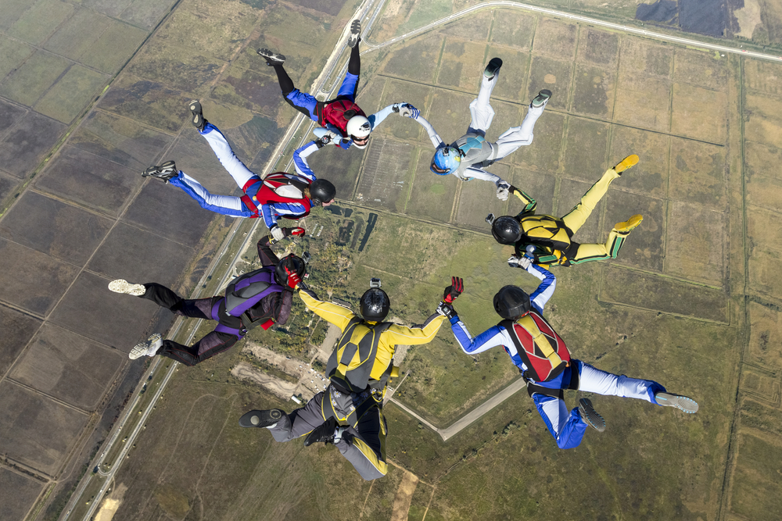
science
Spring
Autumn
How does your garden grow?
Rock Detectives
Amazing Bodies
Our Changing World
Summer
Can you see me?
Forces

Slide 12
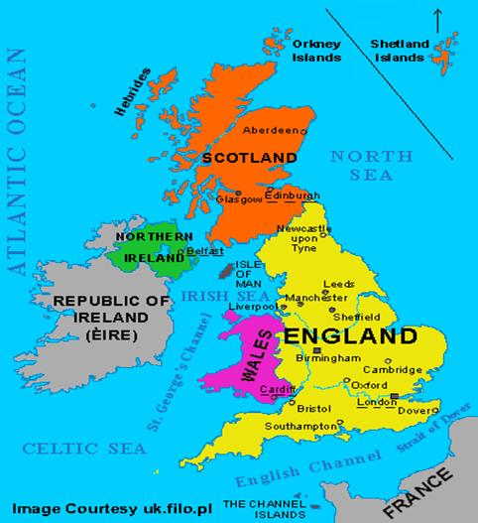
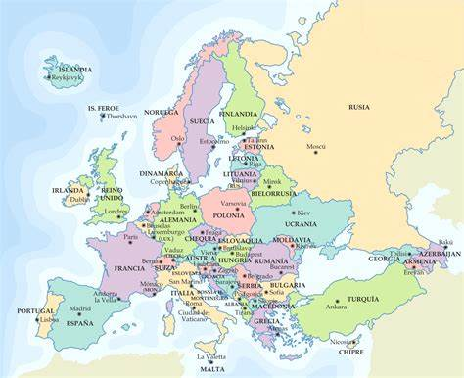
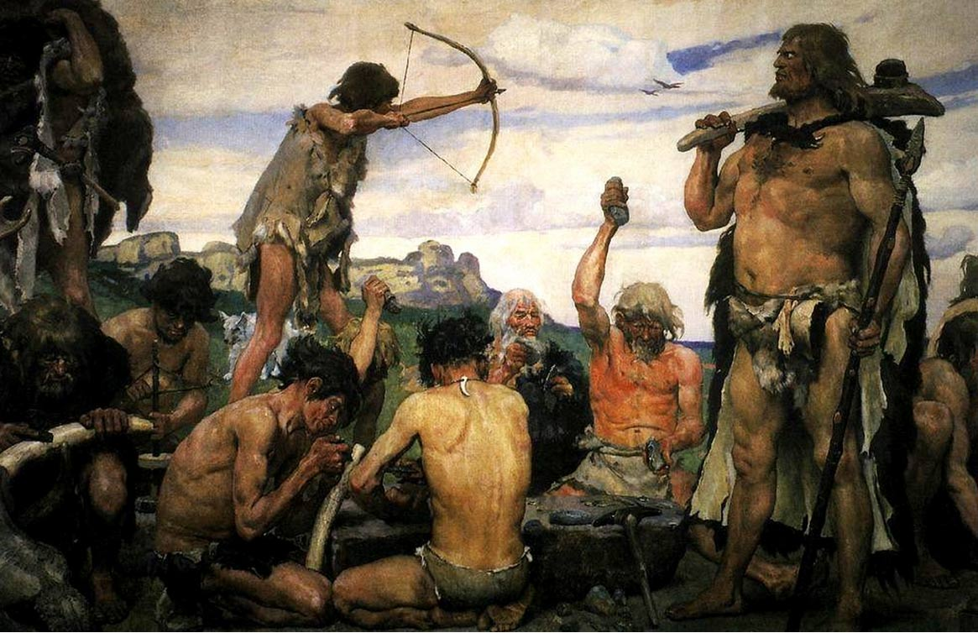
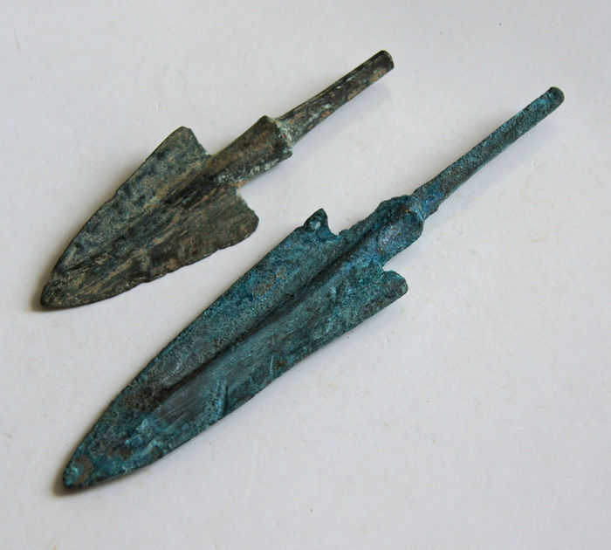
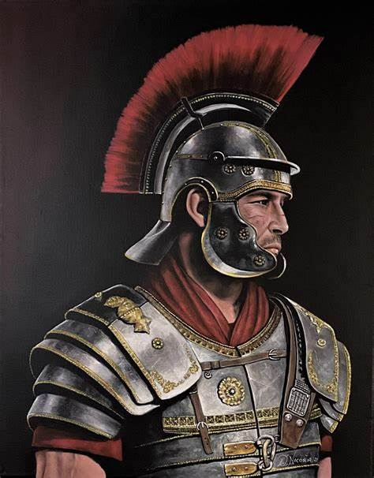
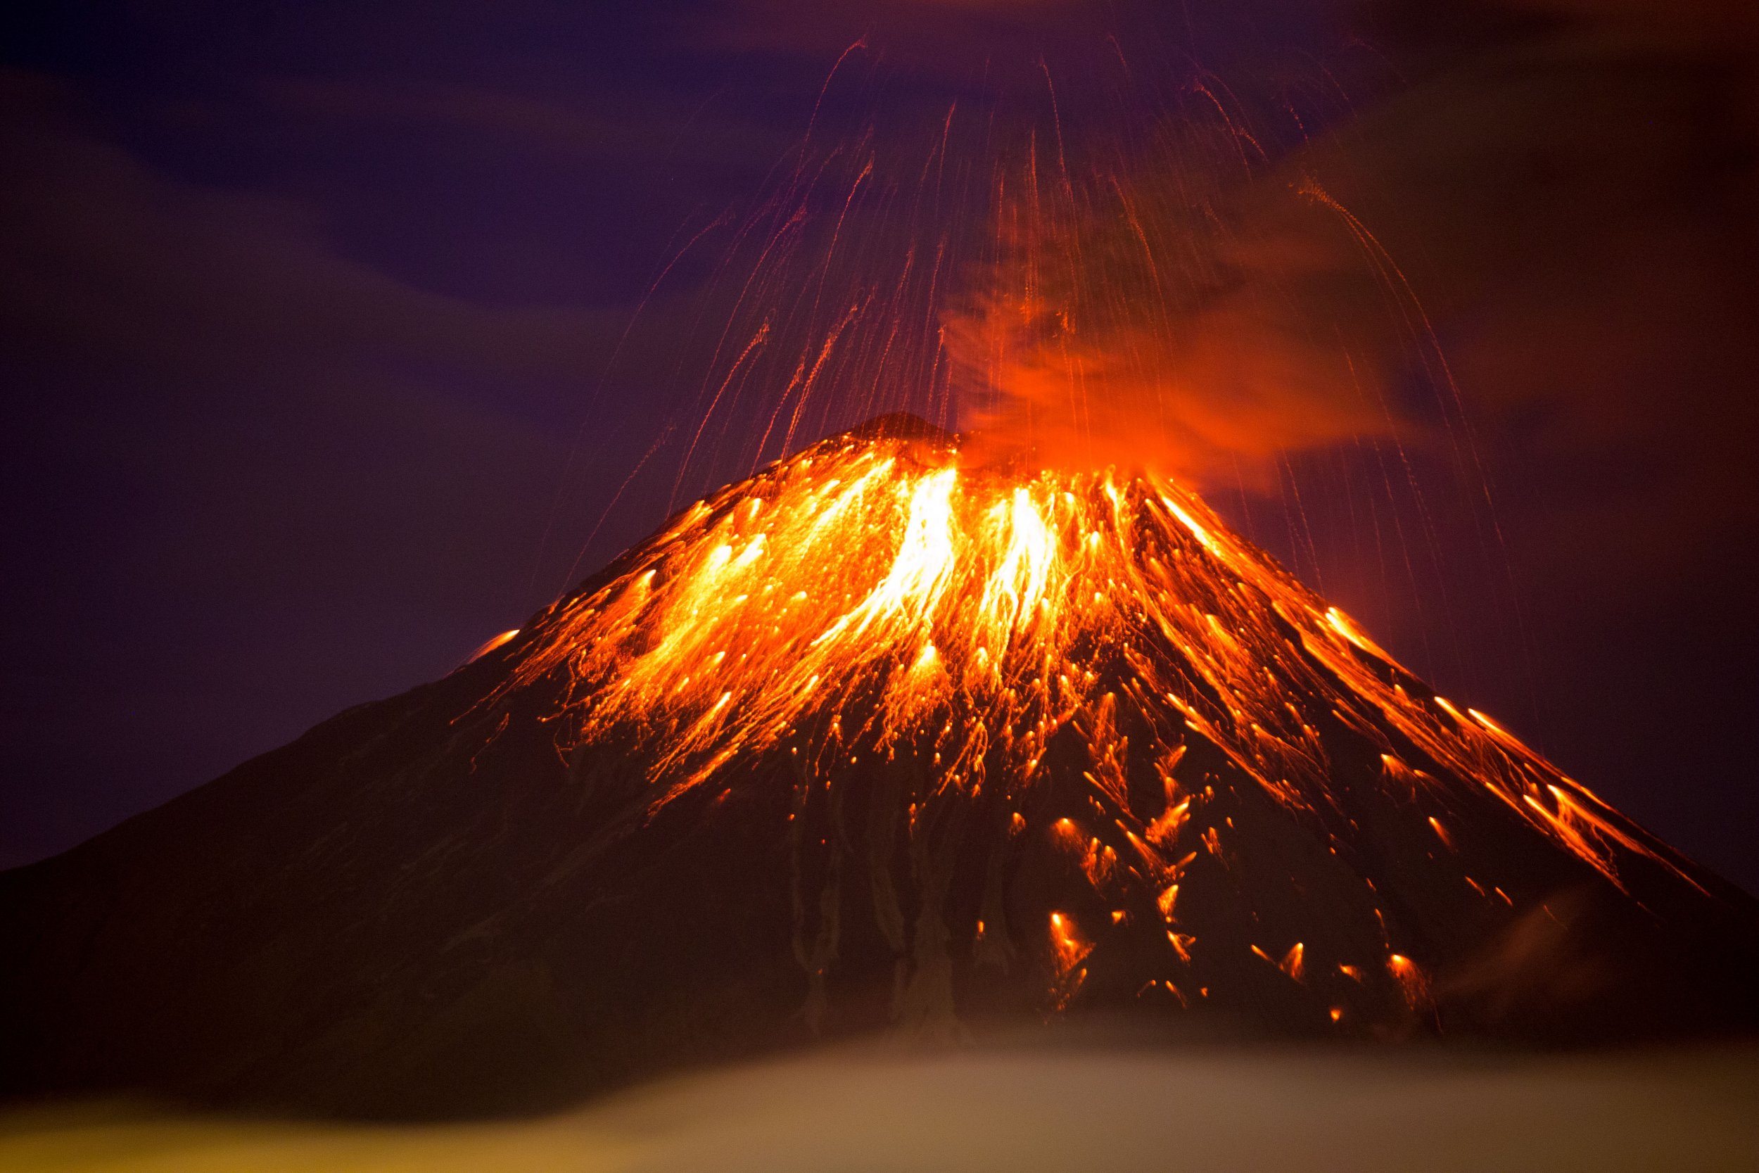
History and Geography
Autumn
Spring
Geography
How are the British Isles connected?
Geography
How am I connected to Europe?
History
Who were the first settlers? (The Stone Age)
History
The Bronze age to the Iron age
History
Why were the Romans powerful and how did they change the world?
Summer
Forces
Geography
Why is the world angry?

Slide 13
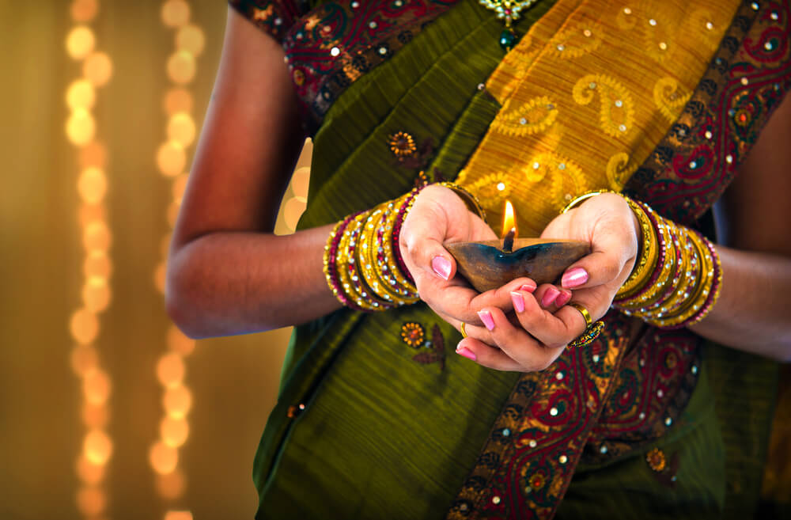
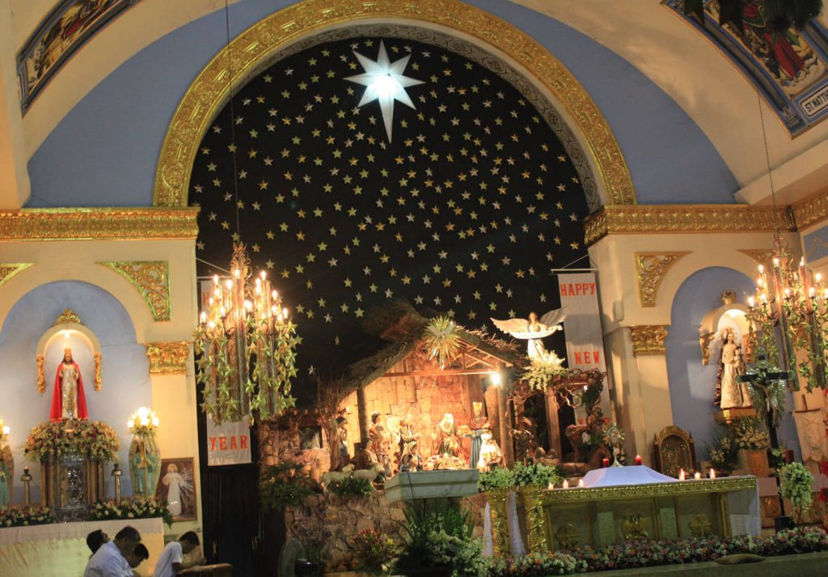
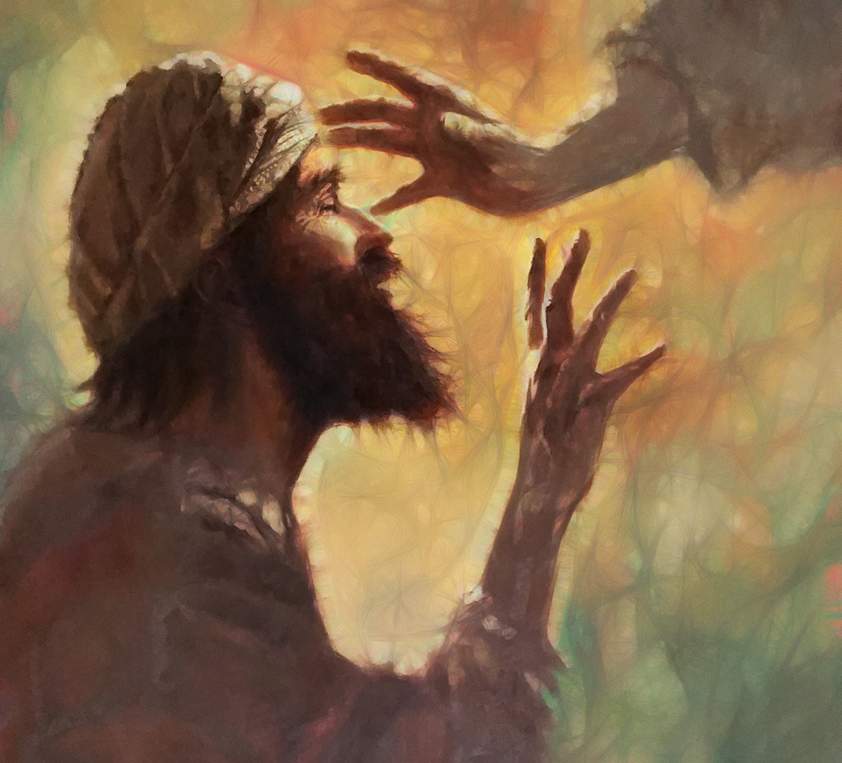
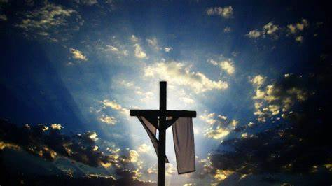
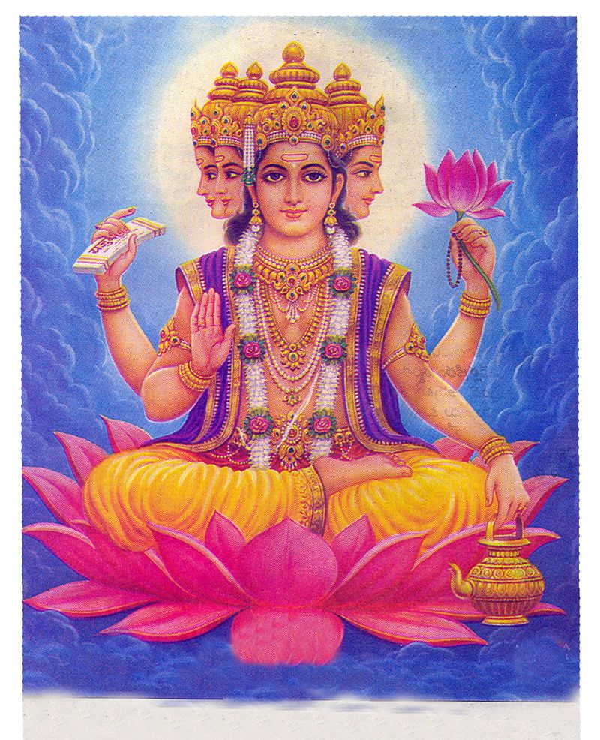
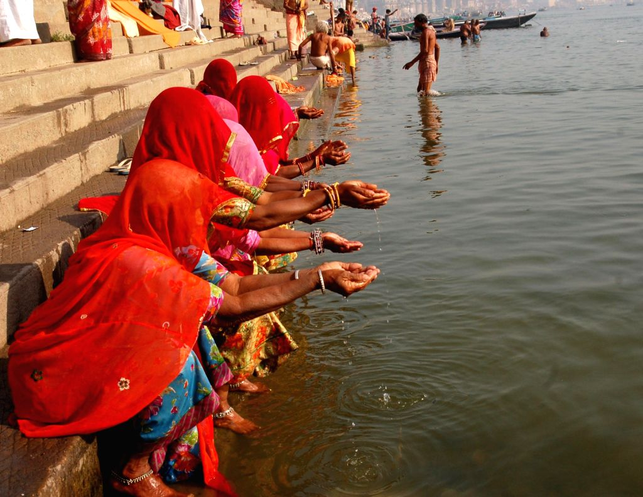
Religious studies
Autumn
Spring
Hinduism
Celebrating Diwali
Christianity
The meaning of Christmas
Christianity
Jesus and his miracles
Christianity
The Easter story
Summer
Hinduism
Brahman is everywhere
Hinduism
The River Ganges

Slide 14
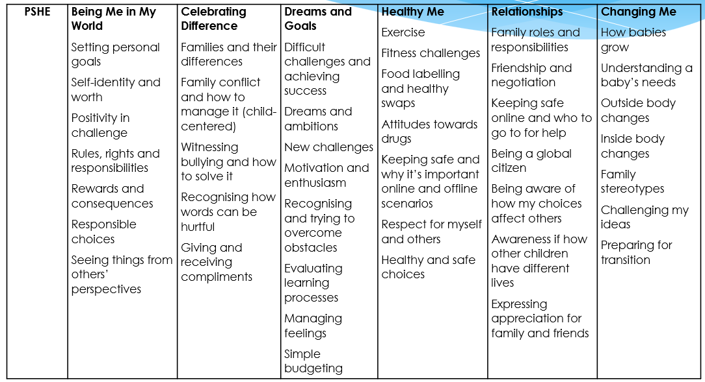
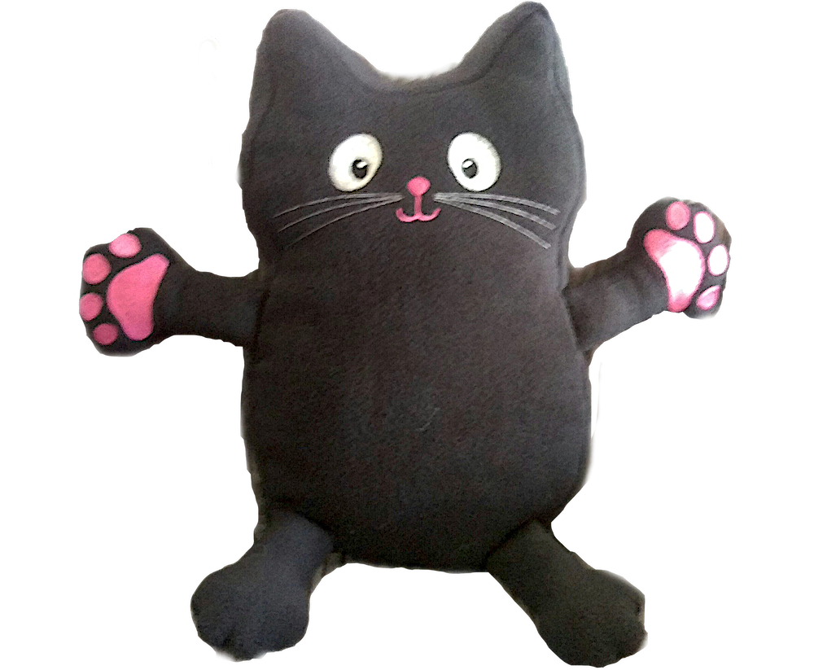
PSHE

Slide 15
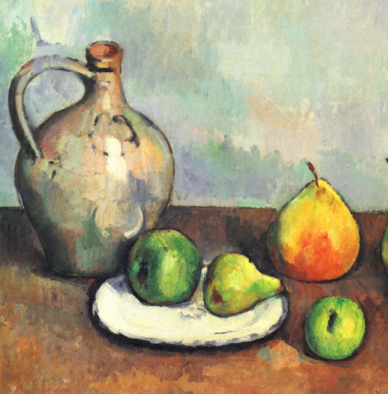
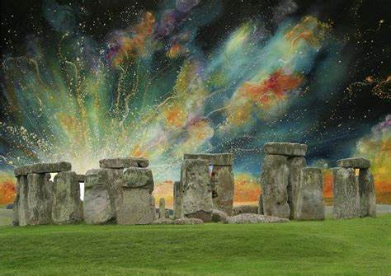
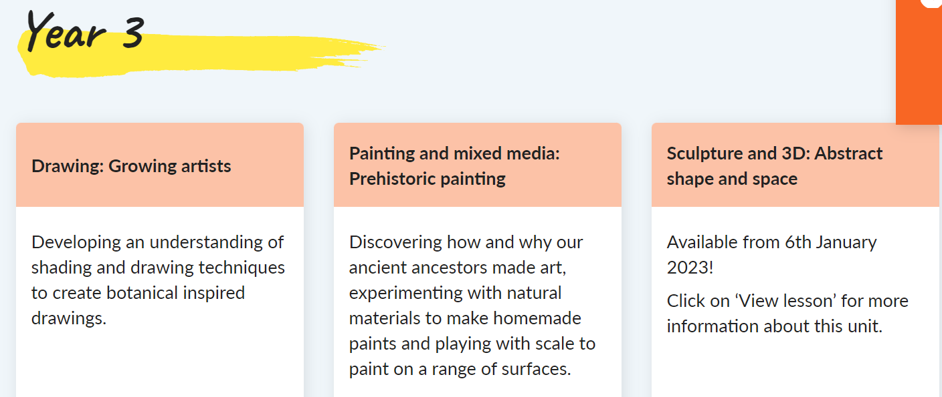
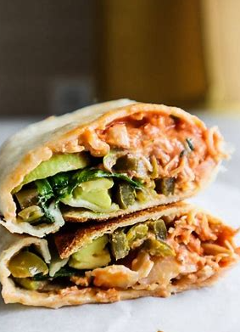
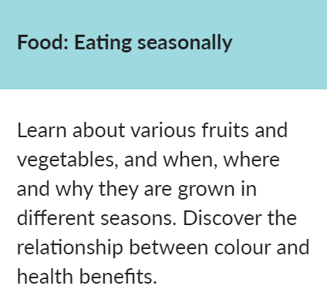
Art and Design and Technology

Slide 17
Celebrations Assembly
Every Friday, children attend a Celebrations Assembly.
A ‘Star of the Week’ certificate is given to one child. This award is for making exceptional progress in an area of their learning and/or behaviour.
One child will also be given a ‘Values’ certificate each week for showing the value of the month.
One child will receive a runner of the week award
One child will be given a Times Table Champion award

Slide 18
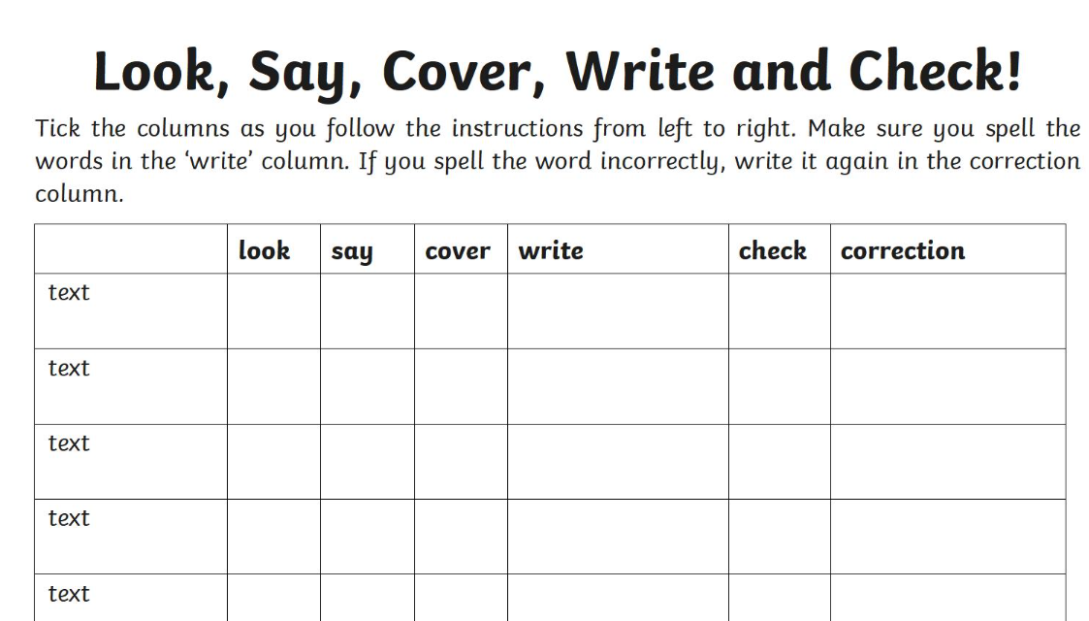
Homework
Homework includes:
Homework will be given on a Friday. Please return completed work to school by the following Wednesday.
Spelling and Times Tables tests will take place weekly.

Slide 19
Reminders
School starts at 8:40am. Please ensure that your child arrives on time.
Please ensure that your child is collected promptly at 3:20pm
If your child is very unwell, please telephone the school on the day they are absent so that the registers can be marked accordingly.
Children are able to bring a piece of fruit for a morning snack.

Slide 20
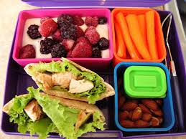
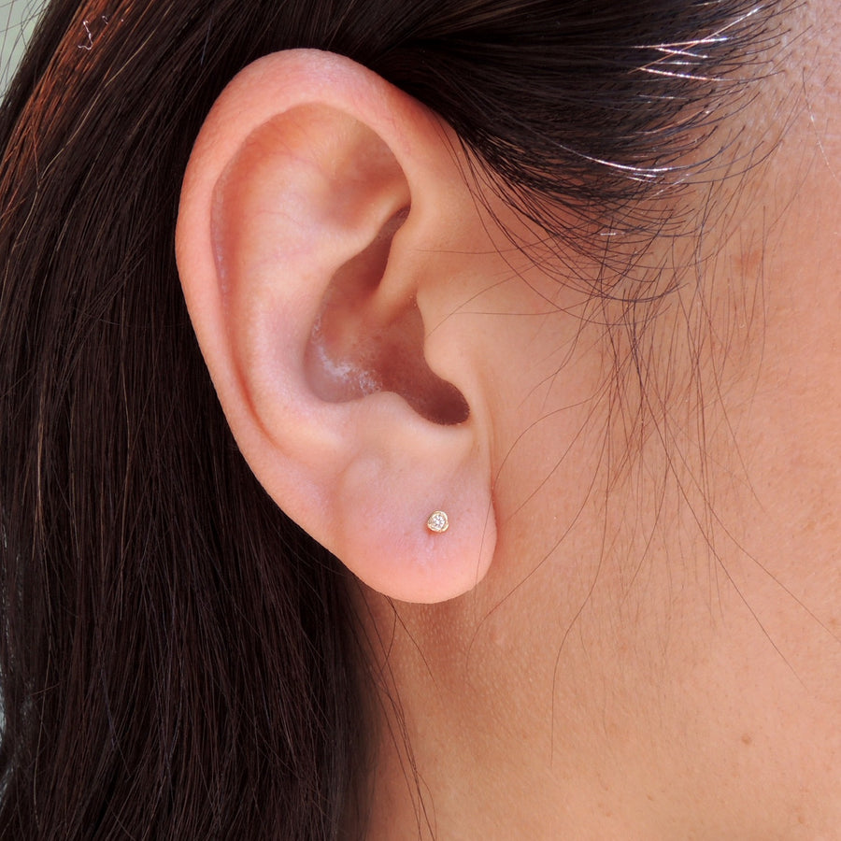
Reminders
Encourage good learning behaviours. Ensure that your child has a quiet place to do their homework.
Children should be able to maintain their concentration for a short period of time while they are doing their homework.
Pack-lunches should be well balanced and healthy.
Please ensure children are in full school uniform when the come to school. Jewellery is not permitted.

Slide 23
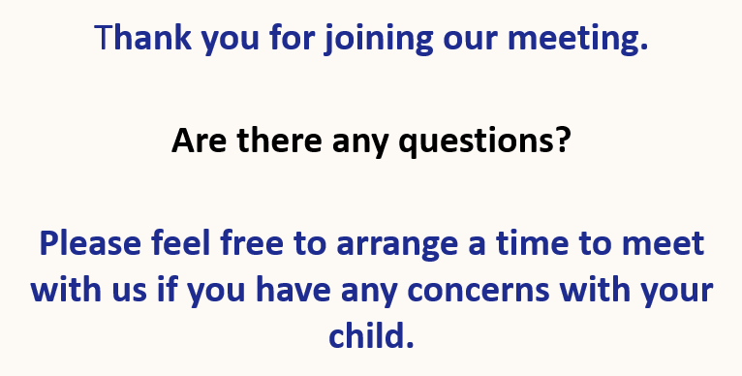
THANK YOU

