Slide 1

Year 4
Meet the Teacher
WELCOME

Slide 2

Meet the Team
Assistant Head Teacher Years 3 and 4
Mrs Lachani
Class Teachers
4L – Miss Shah
4Y – Mr Hijaz
4O – Miss Whilby
4N – Miss Eusebe
Support Staff
Mrs Siyani
Mrs Guiga

Slide 3



Autumn Term
ENGLISH | Text: Writing Outcome: Diary Entry |  |  | Text: Writing Outcome: Persuasive Letter
MATHS | Counting in steps of 50 and 100 Counting in steps of 3, 4 and 8 10 more and less than given numbers 100 more and less than given numbers | Place value of digits (hundreds, tens and ones) 10 more and less than given numbers 100 more and less than given numbers | Read and write numbers up to 1000 in numerals and in words Compare and order numbers up to 1000 |  | Add and subtract numbers mentally, including •a three-digit number and ones •a three-digit number and tens •a three-digit number and hundreds | Add and subtract numbers mentally, including •a three-digit number and ones •a three-digit number and tens •a three-digit number and hundreds

Slide 4
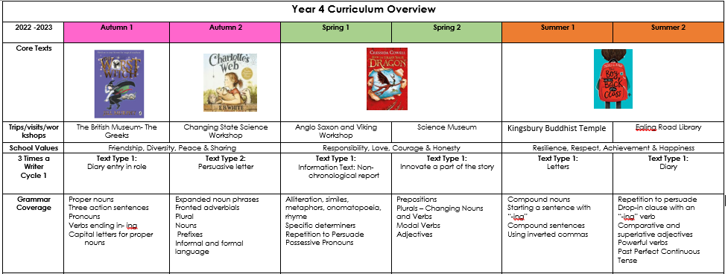
Topics for the Year
English

Slide 5
Maths | Number and Place Value | Addition and Subtraction / Multiplication and Division | Measurement | Geometry | Statistics | Review of Objectives (Based on Teacher Judgements)
Science | Who am I? | In a State | Good Vibrations | Where does that food go? | Human Impact | Switched On

Slide 6
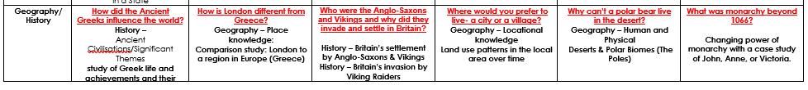

Slide 7
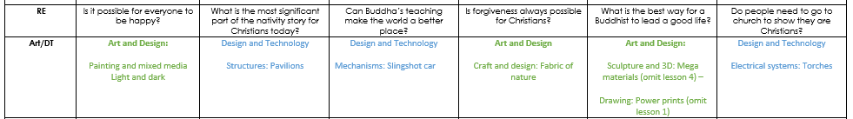

Slide 8
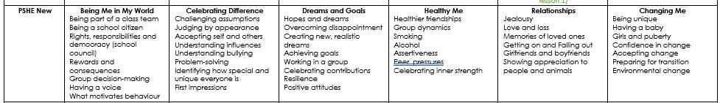

Slide 9

Reading
Children should be reading daily at home. Please listen to them read as often as possible.
Home Reading logs need to be signed by a parent/carer once a week.
It is important to question children whilst reading:
What is happening?
Why has this happened?
What were the key events? etc.

Slide 10
Reading
Children should bring their books to school every day.
Books will be given to children based on their ZPD level.
Children will take an online quiz about their book each week and are expected to get at least 70%.

Slide 11
Reading
Please ensure books are looked after.
Lost or damaged reading books will result in at least a £5.00 fine (dependent on the cost of the book).
Lost or damaged Logs will result in a £1.50 fine.
50p to replace the plastic wallet

Slide 12
Homework
Homework includes:
Homework will be given on a Friday. Please return completed work to school by the following Thursday.
Spelling and Times Tables tests will take place weekly.

Slide 13
Spellings
Children will be given a list of words every Friday.
Please help them to learn the words off by heart. It may be helpful to display the spelling sheet somewhere in the house to encourage your child to practise their spellings everyday.
Notes:
SC

Slide 14
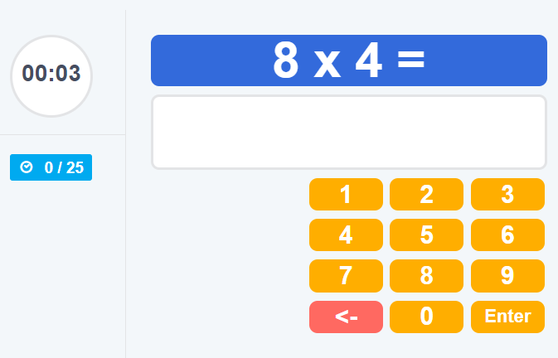
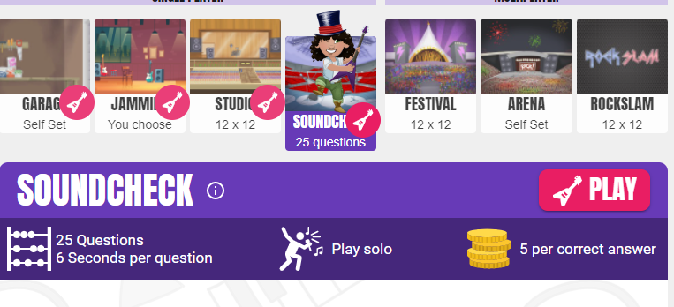
Time Tables
By the end of year 4 all children are expected to know their times tables up to 12x 12 off by heart.
How to support your child
Do daily practice for at least 10 minutes a day.
Practice by rote learning.
Ask your children out of order multiplication questions. E.g. 5x6= 11x12=
Sing times table songs
Multiplication Tables Check - 2022 - Timestables.co.uk
TTRS Rockstars Times Tables Rock Stars: Play (ttrockstars.com)

Slide 15
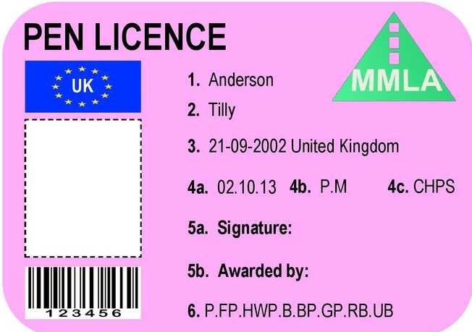
Handwriting
We are now teaching the children to write in cursive handwriting. Please encourage them to practise this at home. They will need to demonstrate amazing presentation in the books in order to get a pen licence!

Slide 16



P.E, Music and Spanish
PE is every Thursday.
The children should come to school in:
dark track suit bottoms, trainers and house
t - shirt, warm jumper for outside in winter.
Children will also do Spanish and Music lessons.

Slide 17

Celebration Assembly
Every Friday, children attend a Celebrations Assembly.
A ‘Star of the Week’ certificate is given to one child. This award is for making exceptional progress in an area of their learning and/or behaviour.
One child will also be given a ‘Values’ certificate each week for showing the value of the month.
One child will receive a runner of the week award
One child will be given a Times Table Champion award

Slide 18

House Keeping
School starts at 8:40am. Please ensure that your child arrives on time.
Please ensure that your child is collected promptly at 3:20pm
If your child is very unwell, please telephone the school on the day they are absent so that the registers can be marked accordingly.
Children are able to bring a piece of fruit for a morning snack.

Slide 19
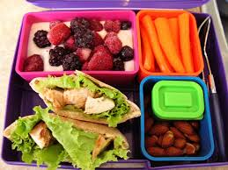
House Keeping
Encourage good learning behaviours. Ensure that your child has a quiet place to do their homework. Children should be able to maintain their concentration for a short period of time while they are doing their homework.
Pack-lunches should be well balanced and healthy.
Please ensure children are in full school uniform when the come to school. Jewellery is not permitted.

Slide 20

Useful Websites
Times Tables:
http://www.teachingtables.co.uk/
Maths
https://www.topmarks.co.uk/maths-games/5-7-years/counting
English
https://www.bbc.com/bitesize/topics/zprrd2p
Phonics
https://www.phonicsplay.co.uk/
General
http://www.crickweb.co.uk/
http://www.ictgames.com/

Slide 21



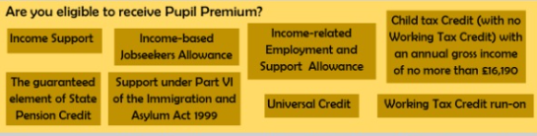
Pupil Premium Grant
The pupil premium is a Government scheme that provides funding of up to £1,320 per eligible pupil.
Why should I apply?.
Quick and easy to apply
Free School meals
Extra support in school
Subsidised music lessons
Subsidised trips
Free vouchers
How to apply?
Ring the office to arrange an appointment.
Your Full name
• Full address including postcode
• An email address
• A contact number
Alternatively, ring the school office to make an appointment.
• Your National Insurance (NI) or National Asylum Support Service (NASS) number
• Your date of birth
For the children that you are applying you will also need their full names, DOB and address if it is different from yours.

Slide 22

Thank You
Thank you for joining our meeting.
Are there any questions?
Please feel free to arrange a time to meet with us if you have any concerns with your child.

