Slide 1
Year 5 – Autumn Term
Meet the Teachers
WELCOME

Slide 2

Meet the team
Acting Deputy Head Teacher Year 5 and 6
Mr Moran
Class Teachers
5L – Mrs Vereha
5Y – Miss Poku
5O –Miss Carsane
5N – Ms Eldridge
Support Staff
Mrs Bokhari
Mrs Bamrah

Slide 3
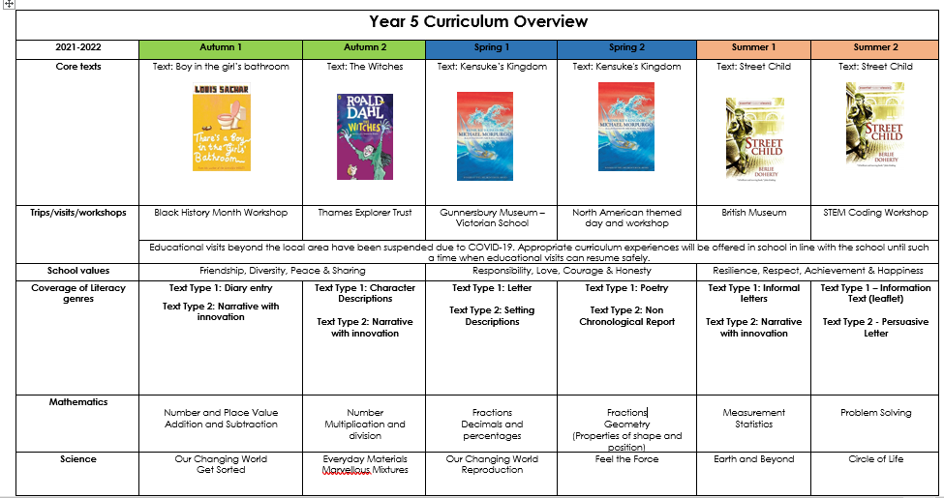
Curriculum Overview

Slide 4
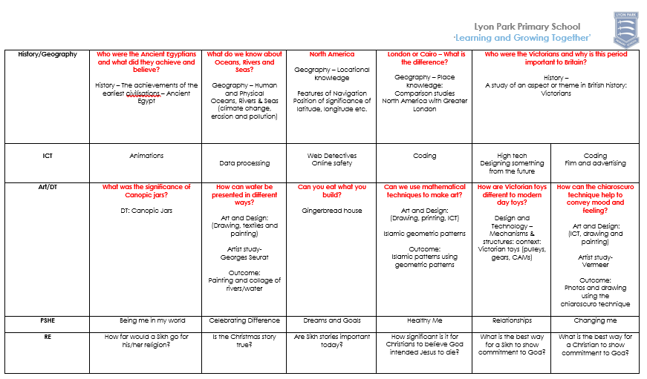
Curriculum Overview

Slide 5
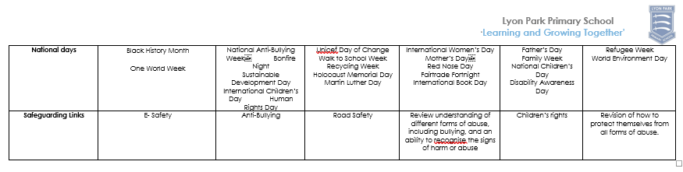
Curriculum Overview

Slide 6

Reading
How is Reading being taught?
We do VIPERS for thirty minutes every day at the beginning of the school day.
We do reading from our Accelerated Reader books for half an hour each day.
The children quiz on each book read and they need to achieve an 80% pass mark.
MyOn can be used at home and at school for
further reading practice.
Notes:
sc

Slide 7
Homework
Homework is given weekly.
Your child will get
Maths homework
Spellings
Reading (ideally reading every night for a minimum of 20 minutes). All homework will be monitored by the teacher and Acting Deputy Head Teachers.

Slide 8


Reading at home
Please can you listen to your child read on a regular basis.
This enables us to know how well they are reading at home and how their fluency and comprehension is developing.
Reading books are changed at least once a week. Children are encouraged to read the same book several times.

Slide 9
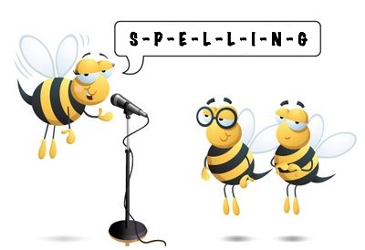
Spellings
The children are being taught spellings through weekly activities.
Children will be given 10 words to learn at home every week and they will be assessed on the following week.
Children need to be taught useful spelling patterns and rules.
Examples: verbs ending with a y which then changes to ies and ied (as in 'copy', 'copies' and 'copied')
Dropping the e off the end of a word when adding -ing, -ed, -er (as in 'hiking', 'hiked' and 'hiker')

Slide 10
Handwriting
Children are expected to use joined handwriting.
They should be encouraged to practise at home.
Pen licences will be awarded throughout the year for consistently neat handwriting and book presentation.

Slide 11
Mathematics and Times Tables
Mathematics is taught every day.
Please help your child learn their times tables.
There are some great websites to help your child build their maths skills.
My Maths is used for weekly homework but can also be used for extra practice.
TTRockstars can be used at home to support the learning of times tables.
Notes:
JF

Slide 12


P.E / Games
PE is every Friday.
Please ensure that the children wear their PE kit to school.
dark joggers
trainers
navy t-shirt
school jumper
no jewellery is permitted
PE is taught outdoors and indoors.

Slide 13
Expectations
Please bring your child to school on time. Gates open at 8:40 am and children start school once children have arrived to the classroom. Please pick children up at 3.20pm.
If your child is unwell please telephone the school on the day they are absent so that the registers can be marked accordingly.
Book bags should hold their home readers and reading records. These should be brought into school daily.
Children should bring a water bottle and a healthy snack each day to help with their learning.
If you need to see the class teacher, please speak to the office staff in the morning or speak to the class teacher after school.

Slide 14
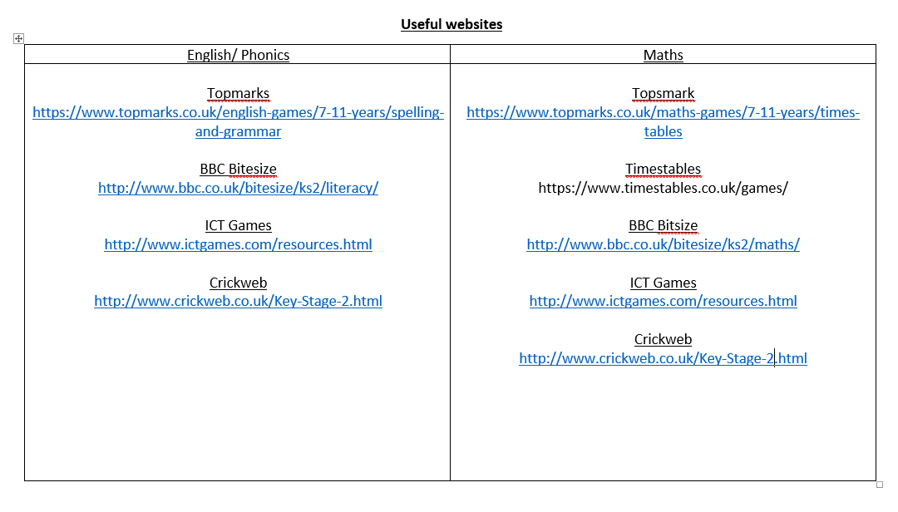
Useful websites

Slide 15
Thank you
Thank you for coming to our
Meet the Teachers
meeting.
Do you have any questions?

