Slide 1
Year 6 – Autumn Term Parent Curriculum Information Meeting
WELCOME

Slide 2
Meet the teachers
Class Teachers
6L Mr Chatton
6Y Ms I Jones
6O Ms M Hunt
6N Mr Viegas
Support Staff
Mrs Shah
Ms Jina
Mrs A Clack

Slide 3
The Autumn Term Curriculum Overview
Literacy: Daily lessons
Diary entries, narratives, formal and informal letters, description, Grammar, Spelling, Vipers, 1-1 reading
Maths: Daily lessons
Read and write numbers up to 10 000 000, using negative numbers in context, decimal numbers in context, multiplication and division, word problems, using estimation to check calculations.

Slide 4
The Autumn Term
Computing: 3D design and data handling
RE: What is the best way to show commitment to God?
PSHE: Being Me in My World
History: The Mayans
Art: Photo Montage
Science: Biology (Body health)
PE: Athletics, Cricket, Gymnastics and Dance
Music: World Music and Cyclic Patterns
Spanish: Day in a school, places in the school (clase, sala de profesores…), Routines, Classroom objects (sacapuntas, goma), School subjects (matemáticas, español, historia), Like/Dislike/hate:

Slide 5
Reading
Reading activities take place every day
Focus on Key skills:
Vipers – Vocabulary, inference, prediction, explaining, retrieval and summarise
Group reading using a shared text, interactive books or book with the class teacher
Individual reading and 1-1 reading for daily readers
Shared reading with whole class
Accelerated Reader
Encourage reading for pleasure

Slide 6
Homework and Reading records
Homework is given each week:
Literacy homework(SPAG.com)
Maths homework (My maths, Times Tables Rockstars)
Spelling homework Reading (daily reading) Parents to log comment once a week.
All homework and reading records will be monitored.

Slide 7
Homework cont…
Literacy homework:
To be completed online.
Maths homework:
To be completed online .
Spellings:
Word lists are made up of words from the national curriculum.
When your child has spellings to learn, please practise the spelling pattern with them as well as learning the words off by heart.
Spelling list for years 3/4 and 5/6
www.spag.com
https://www.mymaths.co.uk/

Slide 8
Reading at home
Library books and Accelerated Reader.
Please listen to your child read on a regular basis and then record your comments in their Reading Log once a week.
Please can you encourage your child to change their book on a regular basis once completed.
Children can access Myon.co.uk from home to read and complete comprehension quizzes.

Slide 9
Mathematics and Times Tables
Mathematics is taught every day in ability groups. Work is set according to ability and children are sometimes given a choice.
Children should know all their times tables up to 12 x
Please help your child learn times tables if they are not confident. There are some great websites, including:
https://www.topmarks.co.uk/maths-games/hit-the-button
Notes:
Please use word assessment instead of tests

Slide 10
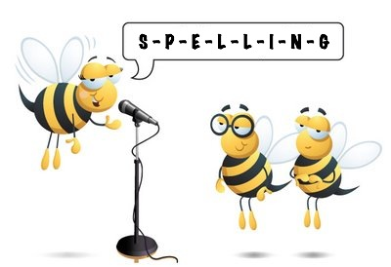
Spellings
The children are being taught spellings through focused weekly activities.
Spelling lists are sent home weekly.
Please help your child practise their spelling using their weekly spelling list.
Notes:
Please use word assessment instead of tests

Slide 11
Home Learning
Online tuition for grammar, spelling, punctuation, Maths (e.g. Discovery education, Purplemash, Khan Academy)
Daily reading, at least thirty minutes. Check for understanding.
Practise spelling daily.
Listen to stories, borrow audio books.
Other media: radio, TV, documentaries.
Use dictionaries and record a vocabulary list.
Notes:
Sumdog

Slide 12
P.E / Games
PE is every WEDNESDAY .
The children will need:
dark joggers;
trainers for outdoors;
house t-shirt;
warm jumper.
Every class will be doing 9 weeks of swimming

Slide 13
P.E
P.E. will be taking place in the hall only when the weather is poor.
Children are encouraged to use plimsolls for indoor P.E.
No jewellery is permitted during P.E.
Encourage children to carry their own water bottles to school.
Children need to come in wearing their PE uniform

Slide 14
Star of the Week
Each week a child will be selected to become ‘Star of the week’.
We award one child per week making exceptional progress in an area of their learning and/or behaviour.
We also give a weekly award to children who displayed an exemplary attitude linked the value of the month.
Notes:
Talk about attitude and effort being an important factor in how well their children progress

Slide 15
House keeping
Please bring your child promptly to school for 8.40am and pick them up promptly for 3.20pm.
In addition, if your child is attending an intervention before school please ensure they arrive on time
If your child is unwell please telephone the school on the day they are absent so that the registers can be marked accordingly.
Classes are awarded attendance awards so encourage your child to contribute as much as they can.
Book bags should hold their home readers and their reading logs. These should be brought to school daily.
Talk to your child at home about their learning and listening.
If you need to speak to the class teacher, please contact the office to make an appointment.

Slide 16
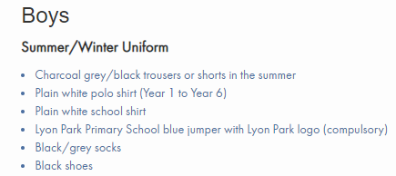
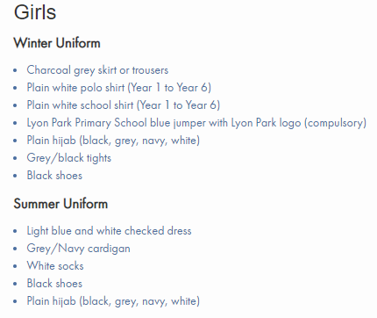
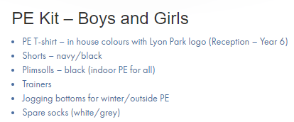
Uniform

Slide 17
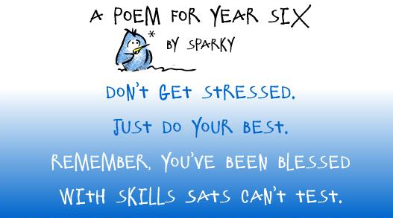
Year 6 SATS
Key stage 2
The key stage 2 tests are timetabled for May 2023.

Slide 18
Application for Secondary Schools
Deadline – 31st October 2022
Two websites on the form www.brent.gov.uk/admissions
After you have decided the school preferences, visit this website www.eadmissions.org.uk to complete the application form.

Slide 19
Thank you for listening
Are there any questions?
Feel free to contact us, through the office, if there are any concerns with your child.

